Slide 1

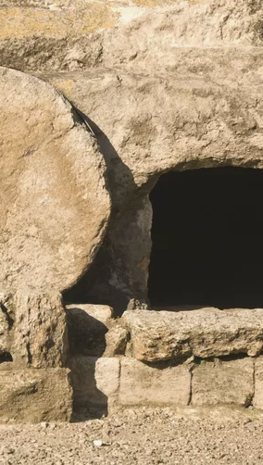
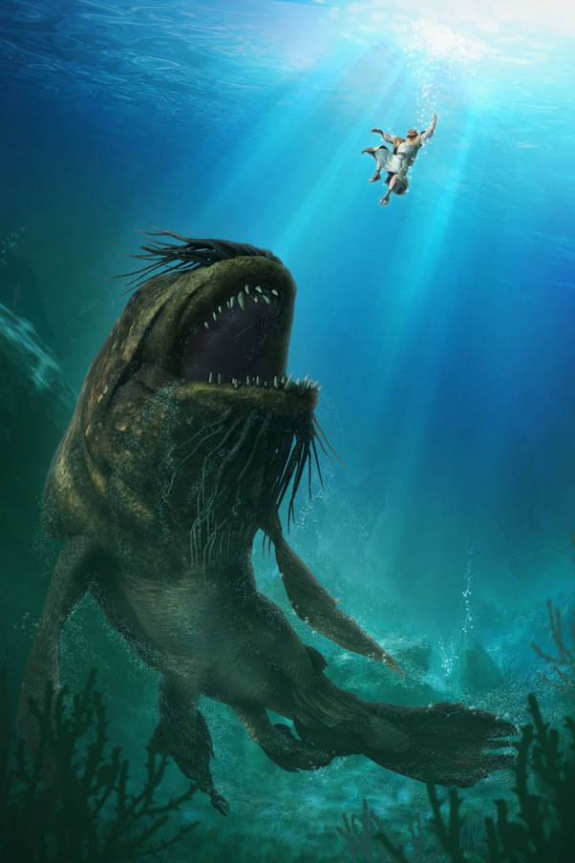
The Sign of Jonah…

Slide 2

^{Matthew 12:38-41}
³⁸ Then some of the scribes and Pharisees answered him, saying, “Teacher, we wish to see a sign from you.” ³⁹ But he answered them, “An evil and adulterous generation seeks for a sign, but no sign will be given to it except the sign of the prophet Jonah. ⁴⁰ For just as Jonah was three days and three nights in the belly of the great fish, so will the Son of Man be three days and three nights in the heart of the earth. ⁴¹ The men of Nineveh will rise up at the judgment with this generation and condemn it, for they repented at the preaching of Jonah, and behold, something greater than Jonah is here….

Slide 3
^{Matthew 16:1-4}
And the Pharisees and Sadducees came, and to test him they asked him to show them a sign from heaven. ² He answered them, “When it is evening, you say, ‘It will be fair weather, for the sky is red.’ ³ And in the morning, ‘It will be stormy today, for the sky is red and threatening.’ You know how to interpret the appearance of the sky, but you cannot interpret the signs of the times. ⁴ An evil and adulterous generation seeks for a sign, but no sign will be given to it except the sign of Jonah.” So he left them and departed.

Slide 4
Luke 11:29-32
When the crowds were increasing, he began to say, “This generation is an evil generation. It seeks for a sign, but no sign will be given to it except the sign of Jonah. ³⁰ For as Jonah became a sign to the people of Nineveh, so will the Son of Man be to this generation.
³¹ The queen of the South will rise up at the judgment with the men of this generation and condemn them, for she came from the ends of the earth to hear the wisdom of Solomon, and behold, something greater than Solomon is here. ³² The men of Nineveh will rise up at the judgment with this generation and condemn it, for they repented at the preaching of Jonah, and behold, something greater than Jonah is here.

Slide 5
Narrative of Jonah
Jonah 1
God: “Arise Go to Niniveh”
Jonah flees from “ADONAI’s face”
Boards a boat to Tarshish with mariners
God “throws” winds and tempest
Jonah “descends” into the vessel to sleep
Mariners Cast Lots to Determine Why of the Storm
Lot falls on Jonah
Jonah: “Throw me in!”
Jonah 1:14
They cried out to ADONAI and said….
Please ADONAI, please do not let us parish with the life/soul of this man!!
And do not charge innocent blood against us! Because you, ADONAI, have done as you pleased”

Slide 6
1:17
And ADONAI appointed a great fish to swallow Jonah, and Jonah was in the innards of the fish three days and three nights…

Slide 7
Narrative of Jonah
⁵ The waters closed in over me to take my life/soul;
the deep surrounded me;
reeds were wrapped about my head…
⁶ To the ends/heights of the mountains, I descended…
The earth with its bars were about me forever;
But You caused my life to ascend from the pit,
ADONAI my God.
⁷ In my soul/life being turned aside
concerning me,
ADONAI I remembered,
and my prayer came to You;
to Your Holy Temple.
⁸ Those who regard worthless idols
forsake their own lovingkindness…
⁹ But I, with a voice of thanksgiving,
I will make sacrifice;
and that which I vowed,
may I fulfill.
Salvation belongs to ADONAI!”
Jonah 2
2 Then Jonah prayed to the Lord his God from the belly of the fish, ² saying,
“I called out to the Lord, out of my distress,
and he answered me;
out of the belly of Sheol I cried,
and you heard my voice.
³ You cast me to the depths.
Into the heart of the seas,
and currents surrounded me.
All your waves and your billows
passed over me.
⁴ Then I said, ‘I am cast away
from Your eyes….
and yet I shall again look
upon Your Holy Temple.’

Slide 8
What was Jonah’s Miracle?
  Thrown in the sea
  Prayed from the innards of the fish….
  According to his prayer, he cried from:
  The “belly of Sheol” (Realm of the Dead)
  God cast him to the “depths”
  He went “into the heart of the sea.”
  Jonah says he was cast from God’s “eyes”
  The waters closed in over him to take his life
  The “deep” surrounded him
  He descended the distance of “the heights of the mountains.”
  The earth closed its bars behind him forever…..
c.f. Genesis 1:2
  תְהוֹם
הָאָרֶץ
Is any of this taking place inside of a fish yet?

Slide 9
What was Jonah’s Miracle?
After his cry from Sheol…..ADONAI has appointed the fish to swallow him.
According to his prayer, he cried from:
  The “belly of Sheol” (Realm of the Dead)
  He descended the distance of “the heights of the mountains” into the earth.
    The earth “with its bars were about him forever…”
  “But You caused my life to ascend from the pit, ADONAI my God.”

Slide 10
Psalms 30:3
ADONAI, You have brought up my soul from Sheol, you have kept me alive, that I don’t descend/go down to the pit….
בּוֹר/Bor
“Pit/Cistern”
Proverbs 1:10-12
¹⁰ My son, if sinners entice you,
do not consent.
11If they say, “Come with us, let us lie in wait for blood;
let us ambush the innocent without reason;
¹² like Sheol let us swallow them alive,
and whole, like those who go down to the pit;
בּוֹר/Bor
“Pit/Cistern”
Isaiah 14:15
Yet to Sheol you shall be brought down (descended),
to the recesses of the pit…
בּוֹר/Bor
“Pit/Cistern”

Slide 11
Psalm 16:8-10
Messianic Psalm
⁸ I have set ADONAI continually before me;
Because He is at my right hand, I will not be shaken.
⁹ Therefore my heart is glad and my glory rejoices;
My flesh also will dwell securely.
¹⁰ For You will not abandon my soul to Sheol;
Nor will You allow Your Holy One to see “Pit.”
שָֽׁחַת/Shakhat
“Pit, destruction, hole, decay; something destroyed where only a physical void is left behind”
“Nor will You allow Your Holy One to see decay…”

Slide 12
^{Acts 2:29-31}
“Brothers, I may say to you with confidence about the patriarch David that he both died and was buried, and his tomb is with us to this day. ³⁰ Being therefore a prophet, and knowing that God had sworn with an oath to him that he would set one of his descendants on his throne, ³¹ he foresaw and spoke about the resurrection of the Christ, that he was not abandoned to Sheol/Hades, nor did his flesh see decay.
^{Acts 13:34-37}
As for the fact that He raised Him up from the dead, no longer to return to decay, He has spoken in this way: ‘I will give you the holy and sure blessings of David.’ ³⁵ Therefore He also says in another Psalm, ‘You will not allow Your Holy One to undergo decay.’ ³⁶ For David, after he had served the purpose of God in his own generation, fell asleep, and was laid among his fathers and underwent decay; ³⁷ but He whom God raised did not undergo decay.

Slide 13
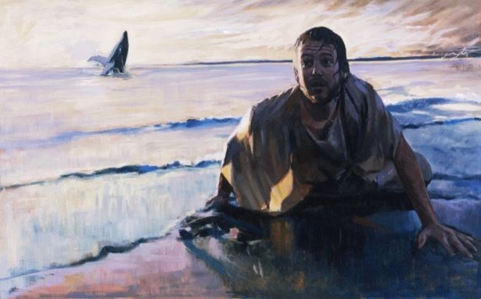
What was Jonah’s Sign?
  But You caused my life to ascend from decay, ADONAI my God.
In my soul/life being turned aside
concerning me,
ADONAI I remembered,
and my prayer came to You;
to Your Holy Temple.
שַׁחַת
RESURRECTION!!!!

Slide 14
What was Jonah’s Sign?
After his cry from Sheol…..ADONAI has appointed the fish to swallow him.
According to his prayer, he cried from:
  The “belly of Sheol” (Realm of the Dead)
  He descended the distance of “the heights of the mountains” into the earth.
  The earth “with its bars were about him forever…”
  God caused Jonah to ascend from Decay.
  After 3 Days and 3 Nights, he returns to the world of the living.
  “But You caused my life to ascend from DECAY, ADONAI my God.”

Slide 15
^{Matthew 12:38-41}
³⁸ Then some of the scribes and Pharisees answered him, saying, “Teacher, we wish to see a sign from you.” ³⁹ But he answered them, “An evil and adulterous generation seeks for a sign, but no sign will be given to it except the sign of the prophet Jonah. ⁴⁰ For just as Jonah was three days and three nights in the belly of the great fish, so will the Son of Man be three days and three nights in the heart of the earth. ⁴¹ The men of Nineveh will rise up at the judgment with this generation and condemn it, for they repented at the preaching of Jonah, and behold, something greater than Jonah is here….
^{John 10:18}
No one takes it from me, but I lay it down of my own accord. I have authority to lay it down, and I have authority to take it up again. This charge I have received from my Father.

Slide 16
I Corinthians 15
Now I would remind you, brothers, of the gospel I preached to you, which you received, in which you stand, ² and by which you are being saved, if you hold fast to the word I preached to you—unless you believed in vain.
³ For I delivered to you as of first importance what I also received: that Christ died for our sins in accordance with the Scriptures, ⁴ that he was buried, that he was raised on the third day in accordance with the Scriptures, ⁵ and that he appeared to Cephas, then to the twelve. ⁶ Then he appeared to more than five hundred brothers at one time, most of whom are still alive, though some have fallen asleep. ⁷ Then he appeared to James, then to all the apostles. ⁸ Last of all, as to one untimely born, he appeared also to me.

Slide 17
I Corinthians 15
¹⁷ And if Christ has not been raised, your faith is futile and you are still in your sins. ¹⁸ Then those also who have fallen asleep in Christ have perished. ¹⁹ If in Christ we have hope in this life only, we are of all people most to be pitied.
²⁰ But in fact Christ has been raised from the dead, the firstfruits of those who have fallen asleep. ²¹ For as by a man came death, by a man has come also the resurrection of the dead. ²² For as in Adam all die, so also in Christ shall all be made alive. ²³ But each in his own order: Christ the firstfruits, then at his coming those who belong to Christ. ²⁴ Then comes the end, when he delivers the kingdom to God the Father after destroying every rule and every authority and power. ²⁵ For he must reign until he has put all his enemies under his feet. ²⁶ The last enemy to be destroyed is death.

